Slide 1
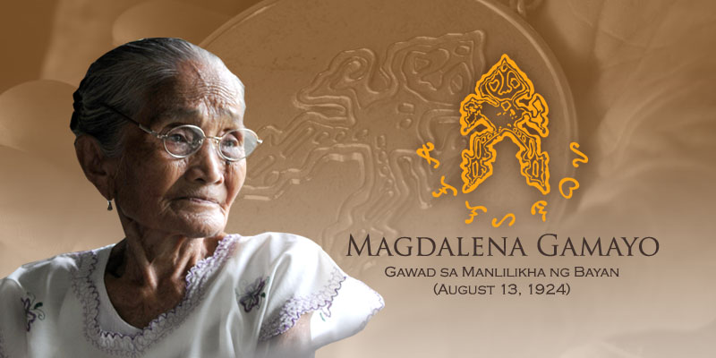
ROWY, CHEDRICK F.

Slide 2
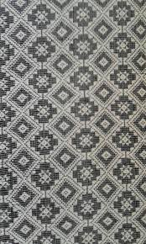
MAGDALENA GAMAYO
Textile Weaver
Ilocos Norte
20 12
Nana Dalen

Slide 3
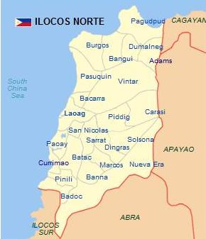

Slide 4
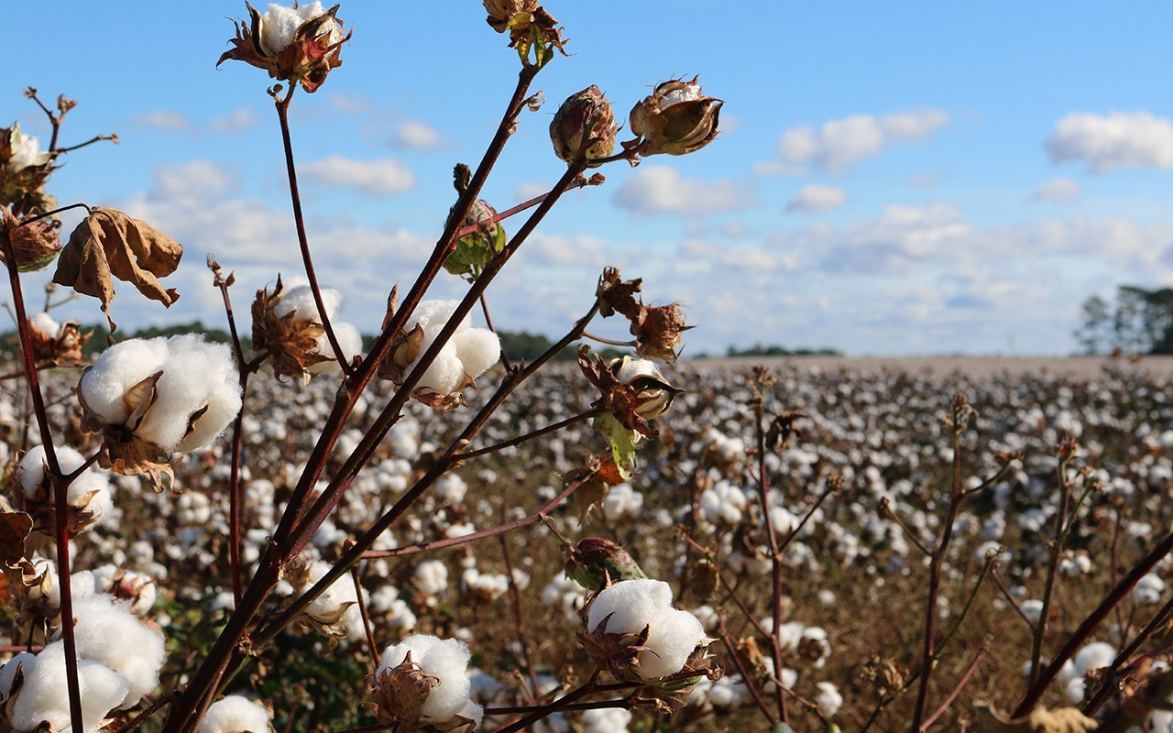

Slide 5
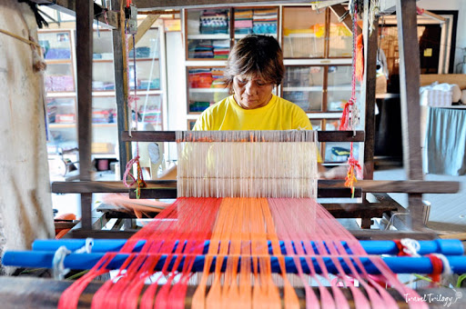

Slide 6
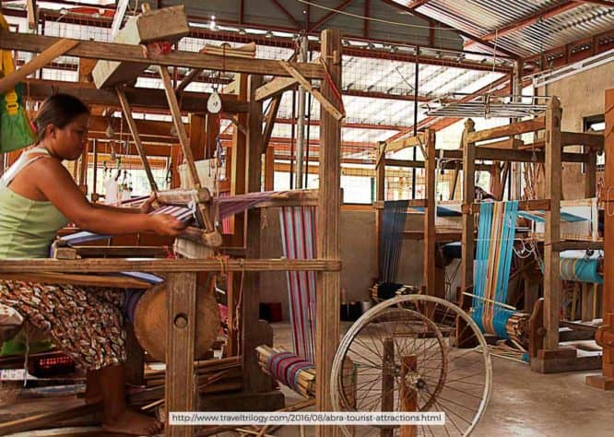

Slide 7
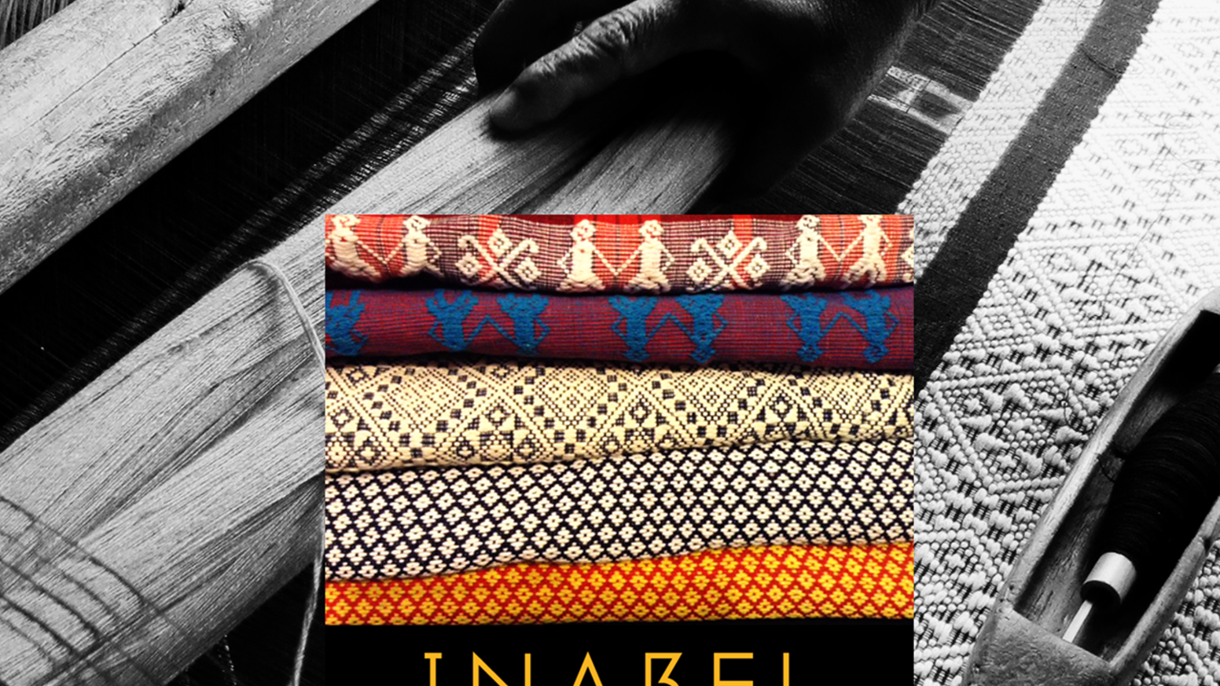

Slide 8
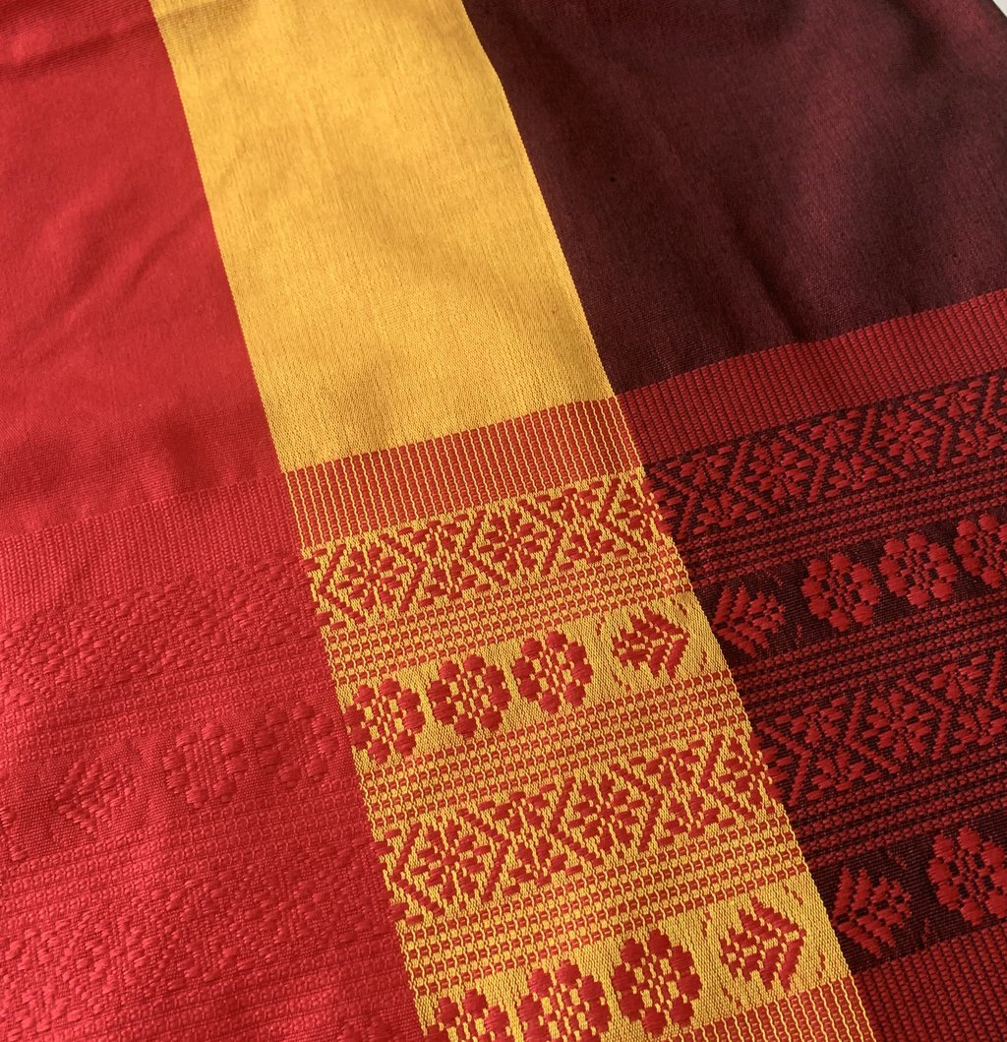
INABEL
Of Ilocos Norte
Ilocano word for “weave”
Made with Cotton (Natural, Reusable Harvest in Ilocos Norte).

Slide 9
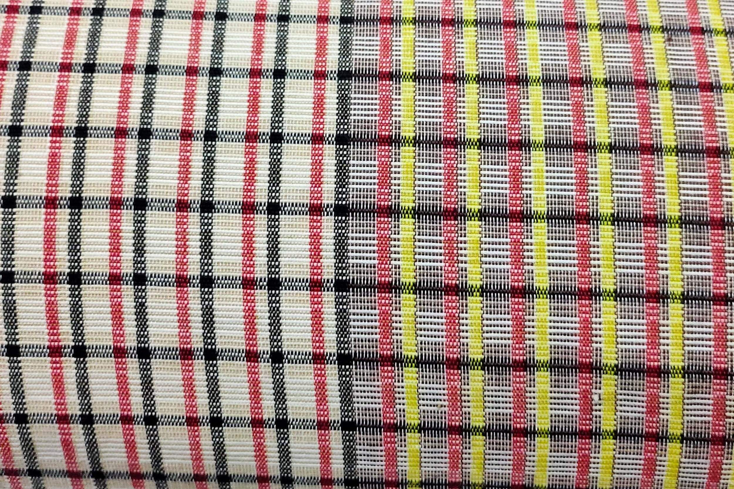

Slide 10
